Slide 1
Optimization of Wearable Biosensor Data for Stress Classification Using Machine Learning and Explainable AI
GUIDE : C Sandhya
BATCH: K Keerthana(21D21A05M9)
S Vennela(21D21A05Q4)
J S R Rajeswari(21D21A05M7)

Slide 2
CONTENTS
ABSTRACT
INTRODUCTION
LITERATURE SURVEY
SYSTEM ANALYSIS
SYSTEM REQUIREMENTS SPECIFICATION
CONCLUSION

Slide 3
ABSTRACT
Utilizing wearable devices for real-time stress detection. Physiological data, including Interbeat Interval (IBI)-derived Heart Rate Variability (HRV), Blood Volume Pulse (BVP), and electrodermal activity (EDA), are collected during the Montreal Imaging Stress Task (MIST). The stress classification methodology employs an integrated approach using Genetic Algorithm and Mutual Information to reduce feature set redundancy. It further uses Bayesian optimization to fine-tune machine learning hyperparameters. The results indicate that the combination of EDA, BVP, and HRV achieves the highest classification accuracy of 75.2% using the Gradient Boosting (GB) algorithm for 2-level and 3-level stress classification. In contrast, EDA and HRV alone achieve a comparable accuracy of 72.3% for 2-level and 3-level stress classification, respectively. Furthermore, the SHAP Explainable AI (XAI) analysis confirms that HRV and EDA are the most significant features for stress classification. The study also finds evidence that listening to meditation audio reduces stress levels. These findings highlight the potential of wearable technology combined with machine learning for real-time stress monitoring and management in academic environments.

Slide 4
ABBREVIATIONS
Interbeat Interval (IBI): Time between heartbeats.
Heart Rate Variability (HRV): Variation in time between heartbeats, indicating stress and emotional responses.
Blood Volume Pulse (BVP): Measure of blood flow and oxygenation.
Electrodermal Activity (EDA): Measure of skin conductivity, indicating stress, anxiety, and emotional arousal.
Montreal Imaging Stress Task (MIST): A standardized test inducing stress through mental arithmetic tasks to assess physiological and psychological responses.

Slide 5
DEFINITIONS
Machine learning is a subset of artificial intelligence (AI) that involves the development of algorithms and statistical models that enable computers to learn from data, make decisions, and improve their performance on a specific task without being explicitly programmed.
SHAP (Shapley Additive Explanations) is an Explainable AI (XAI) technique that assigns a value to each feature for a specific prediction, indicating its contribution to the outcome.

Slide 6
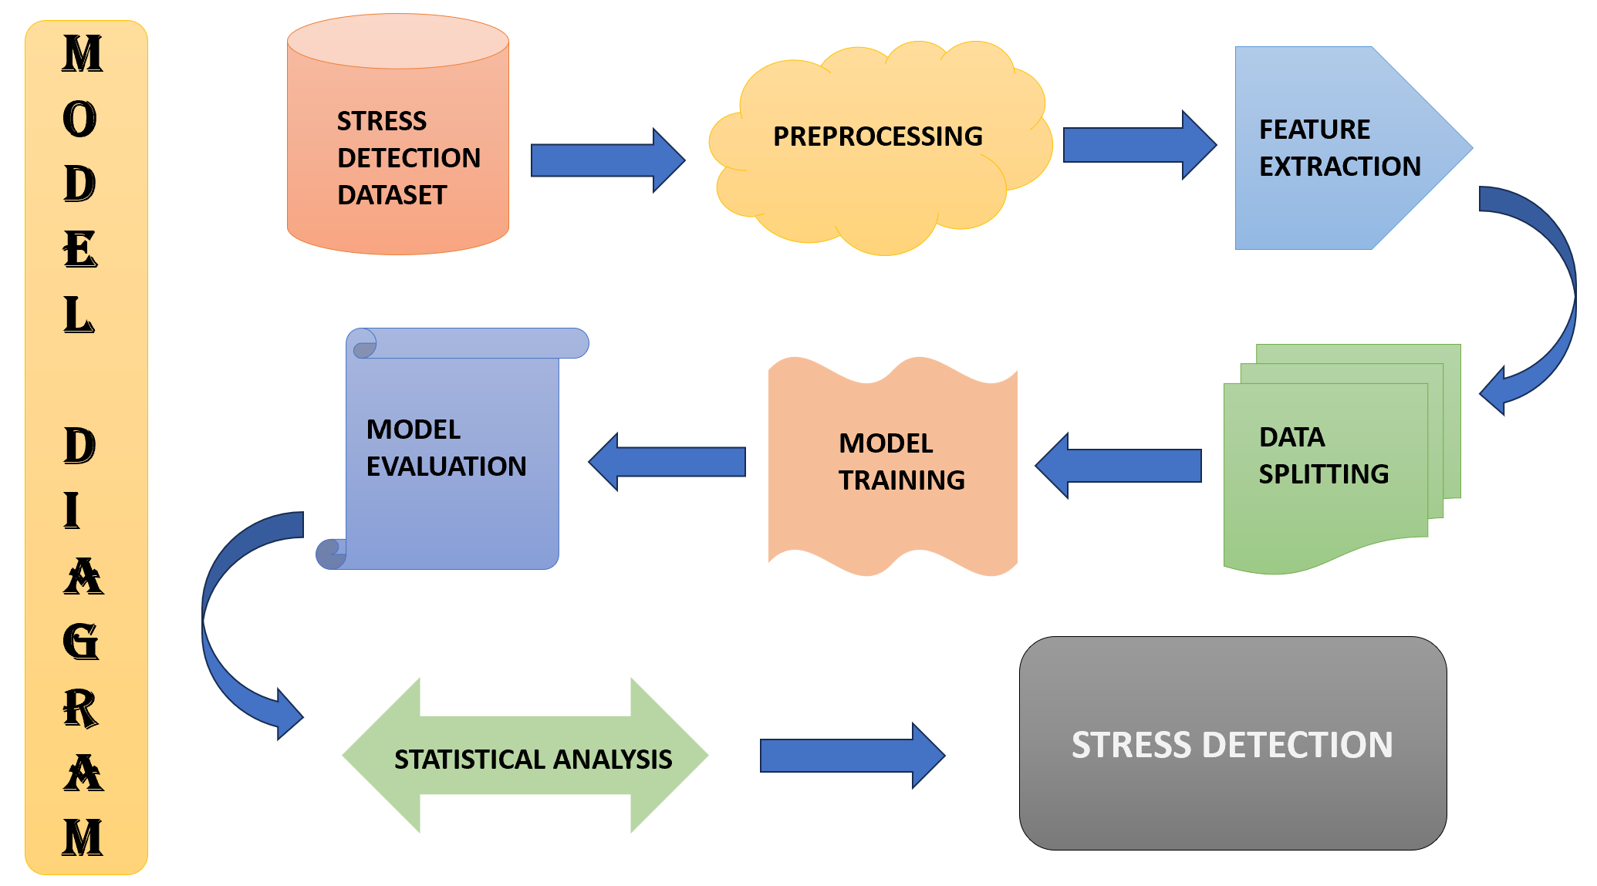

Slide 7
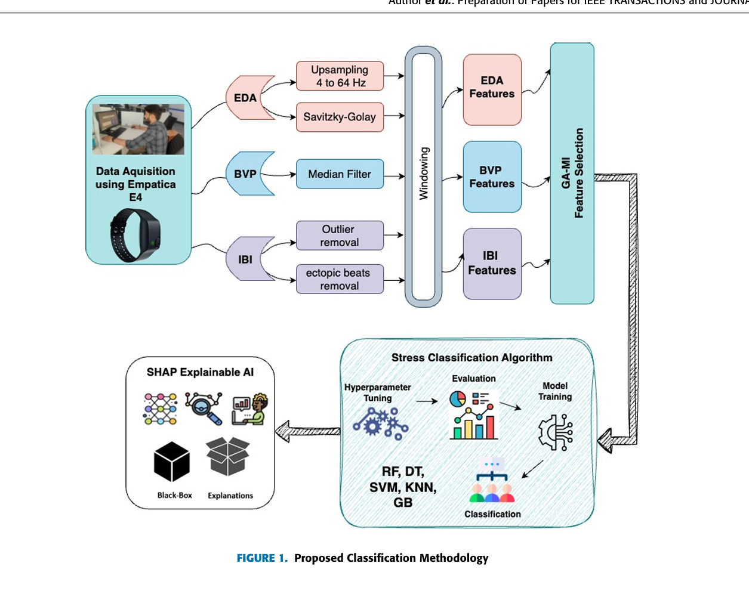

Slide 8
INTRODUCTION
Academic stress significantly impacts student’s well-being and performance.
Wearable technology and machine learning can identify stress indicators through physiological signals.
Researchers use stress-inducing tasks like Montreal Imaging Stress Task (MIST) to analyze signals.
Studies show Electrodermal Activity (EDA) and Heart Rate Variability (HRV) effectively detect stress. Combining EDA and HRV-derived features enhances stress detection accuracy.
However, no research has specifically explored the combination of EDA and ECG during MIST in academic learning contexts.
This study aims to fill this gap and develop a precise stress detection system using wearable biosensors and machine learning.
By recognizing early stress signs, students can manage stress effectively, preventing intensive interventions.

Slide 9
Purpose
The primary purpose of this research is to:
Investigate the feasibility of using wearable devices and machine learning algorithms for real-time stress detection in academic environments.
Examine the effectiveness of meditation audio in reducing stress levels.
Explore the relationship between physiological signals (EDA, HRV, etc.) and stress.

Slide 10
Scope
The scope of this research includes:
Primary Objectives:
1. Develop a wearable device-based stress detection system using machine learning algorithms.
2. Evaluate the accuracy of the system in detecting stress.
3. Investigate the impact of meditation audio on stress reduction.
Secondary Objectives:
1. Identify the most relevant physiological signals for stress detection.
2. Explore the relationship between stress and academic performance.
3. Investigate the potential applications of wearable technology in mental health monitoring.

Slide 11
OVERVIEW
Investigations into academic stress have underscored its negative impact on student well-being and performance.
To address this, researchers are employing wearable technologies to monitor physiological signals, including EDA and ECG.
Integration of these signals with stress-inducing tasks, such as MIST, may enhance stress classification accuracy.

Slide 12
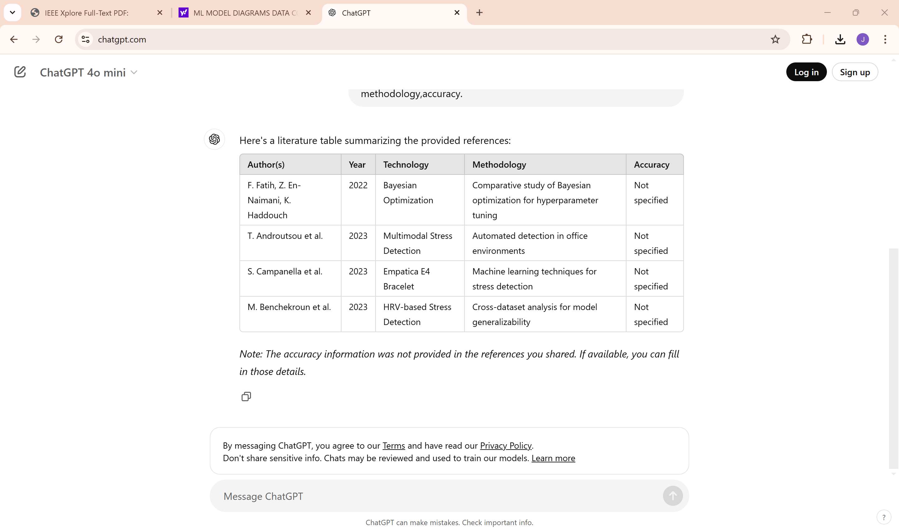
LITERATURE SURVEY
64.3%
66.2%
74.5%
76.0%

Slide 13
SYSTEM ANALYSIS
EXISTING SYSTEM
A machine learning-based stress classification system utilizes various algorithms (RF, DT, SVM, XGB, GB) and physiological signals (EDA, BVP, HRV) to achieve high accuracy (98.28% for 2-level, 97.02% for 3-level classification).
However, limitations exist in terms of signal selection, interpretability, and real-world generalizability.

Slide 14
DISADVANTAGES
The system is optimized for controlled testing conditions, potentially reducing accuracy in varied real-world environments.
Relies mainly on HRV and EDA, potentially overlooking other influential stress indicators.
GB may still limit explainability for end-users.

Slide 15
PROBLEM STATEMENT
Develop an optimized machine learning framework that leverages wearable biosensor data to accurately classify stress levels, while ensuring explainability and generalizability across diverse real-world environments.

Slide 16
PROPOSED SYSTEM
The proposed system integrates advanced hybrid models and additional data sources (ambient noise, temperature) to enhance real-time stress detection accuracy and adaptability.
Key features include Temporal Fusion Transformer (TFT) for temporal sensitivity, AutoML for efficient model selection, and expanded physiological and environmental data inputs for comprehensive stress trigger analysis.

Slide 17
ADVANTAGES
Adapts to diverse environments with expanded data inputs, offering more reliable stress detection in daily academic settings.
Advanced models with explainability features enable more actionable insights for users and educators.
Incorporates environmental and physiological factors, enhancing sensitivity to real-time stress indicators across varied conditions.

Slide 18
SYSTEM REQUIREMENTS SPECIFICATION
FUNCTIONAL REQUIREMENTS
NON FUNCTIONAL REQUIREMENTS
Data Collection
Data Analysis
Data Preprocessing
Model Training
Model Testing
User Interface
Portability
Security
Maintainability
Reliability
Scalability
Performance
Reusability
Flexibility

Slide 19
SOFTWARE REQUIREMENTS
Operating system : Windows 7 Ultimate.
Coding Language : Python.
Front-End : Python.
Back-End : Flask
Designing : Html, css, javascript.
Data Base : MySQL (WAMP Server).

Slide 20
SYSTEM REQUIREMENTS
➢ Processor -Pentium –IV
➢ RAM - 4 GB (min)
➢ Hard Disk - 20 GB
➢ Key Board - Standard Windows Keyboard
➢ Mouse - Two or Three Button Mouse
➢ Monitor - SVGA

Slide 21
SYSTEM DESIGN
System design is a comprehensive approach to creating complex systems that meet specific requirements and needs.
It involves a systematic process of defining, developing, and integrating various components to create a cohesive system.
The goal of system design is to create a system that is efficient, scalable, reliable, and maintainable. It requires a deep understanding of the system's requirements, functionality, and constraints.
By adopting a systematic design approach, projects can ensure a well-structured, efficient, and effective system that meets the needs of stakeholders.
Effective system design considers factors such as functional requirements, performance, security, scalability, usability, reliability, and maintainability

Slide 22
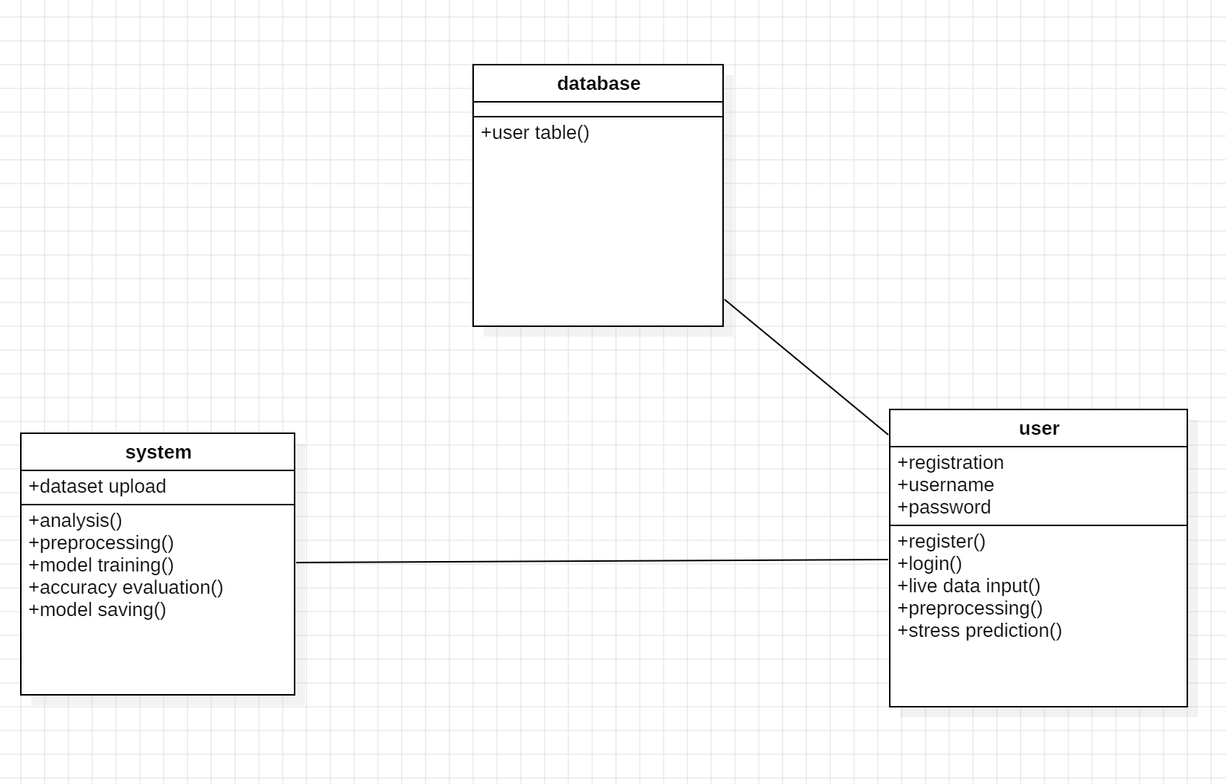
CLASS DIAGRAM

Slide 23
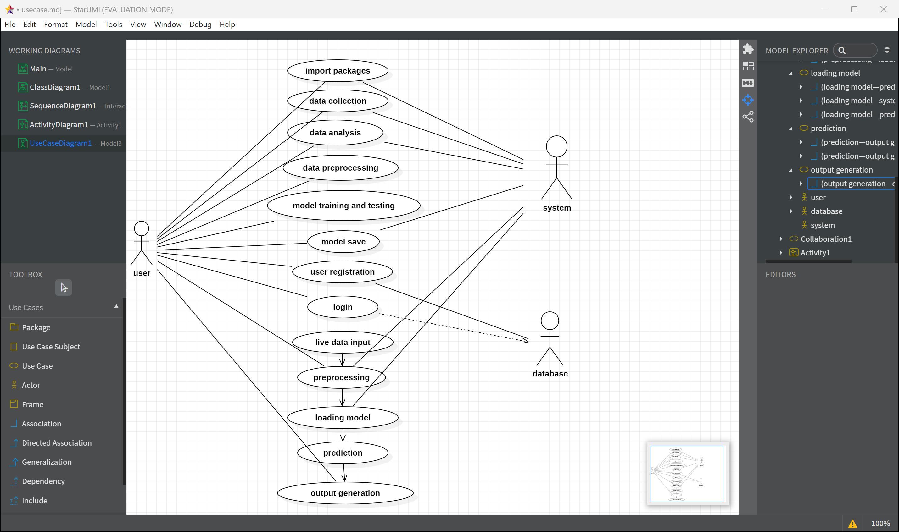
U
S
E
C
A
S
E
D
I
A
G
R
A
M

Slide 24
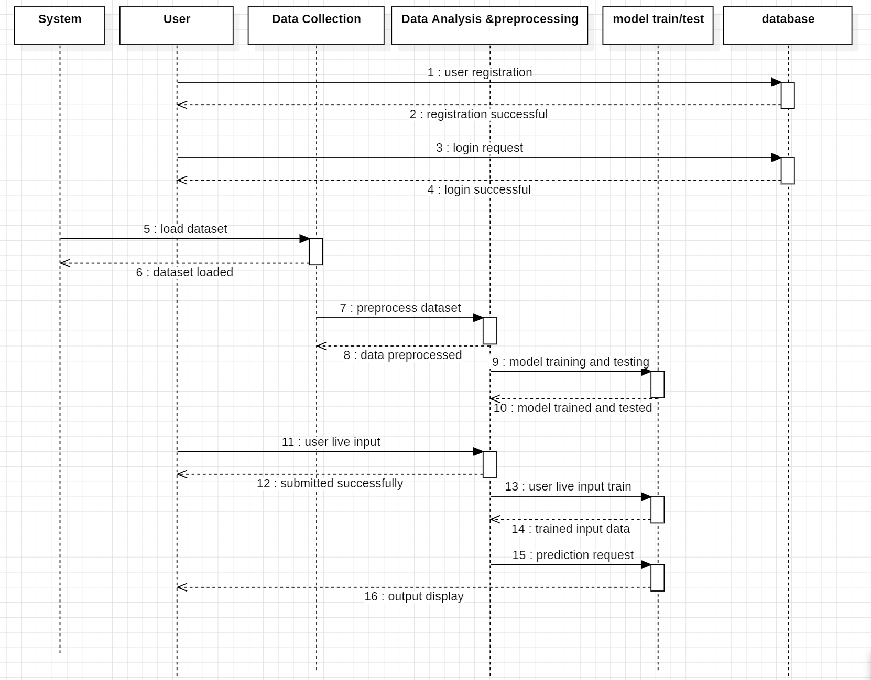
SEQUENCE DIAGRAM

Slide 25
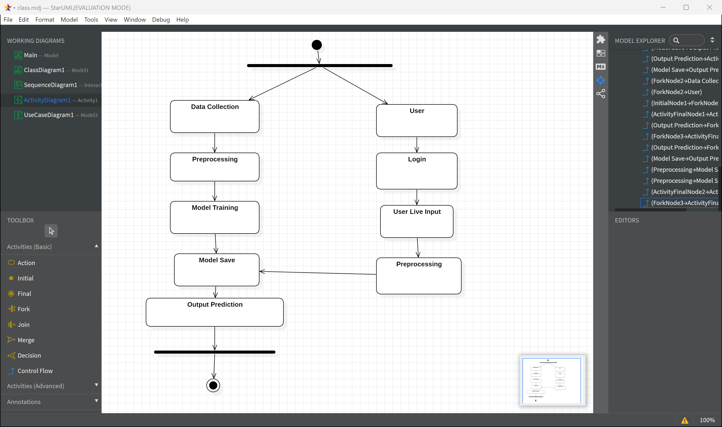
ACTIVITY DIAGRAM

Slide 26
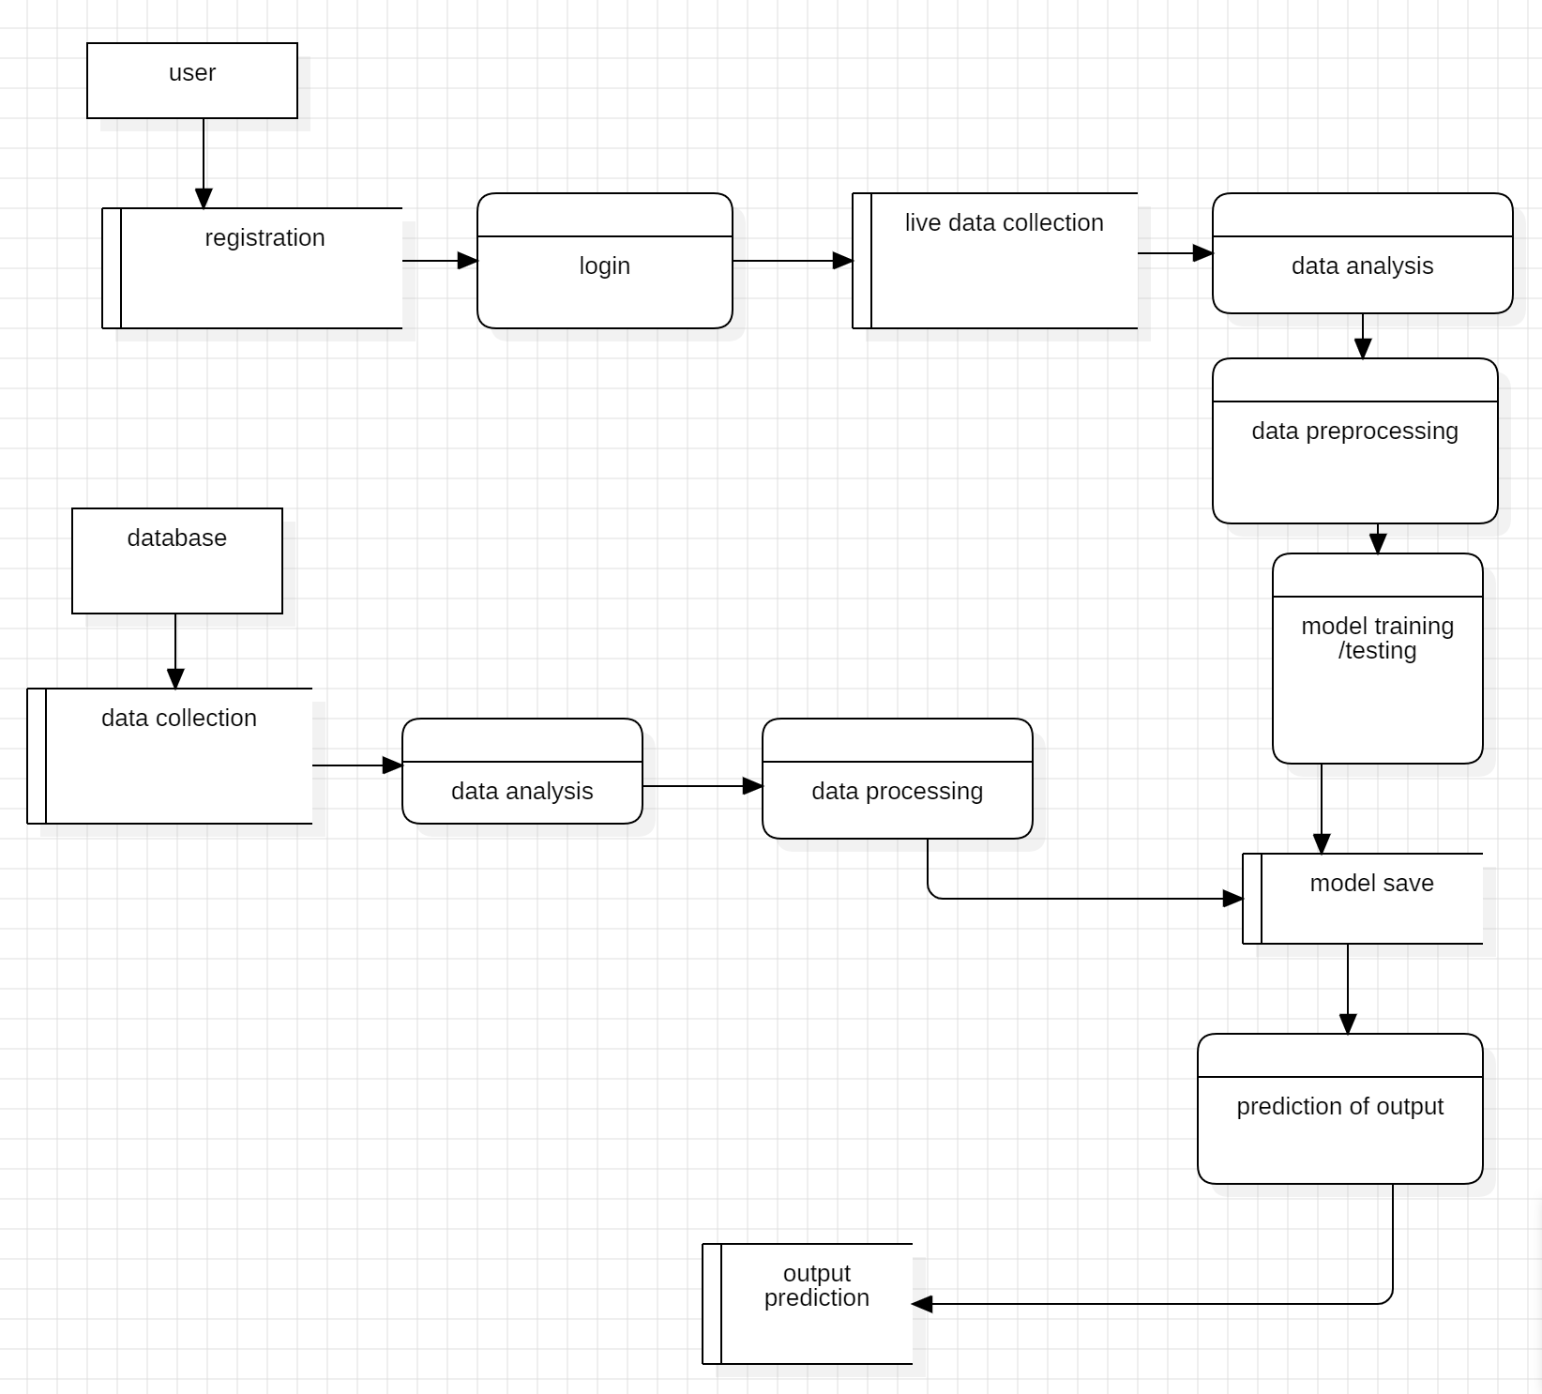
DATA FLOW DIAGRAM

Slide 27
SYSTEM ARCHITECTURE

Slide 28
MODULES
Data Collection
Data Analysis
Data Preprocessing
Model Training and Testing
Output Prediction

Slide 29

IMPLEMENTATION
Import Libraries
Load and Preprocess Data
Define and Train Model
# Load dataset
# Preprocess data
# Split data into training and testing sets
# Define model architecture
# Compile model
# Train model
Output generation
Evaluate Model
# Evaluate model on test data

Slide 30
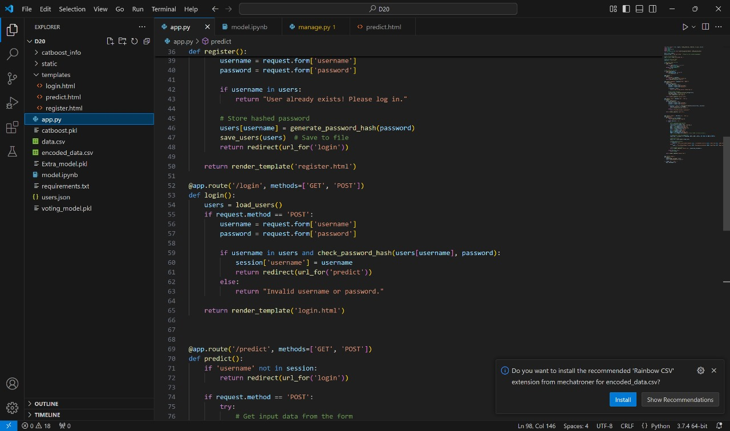
PREDICTION CODE

Slide 31
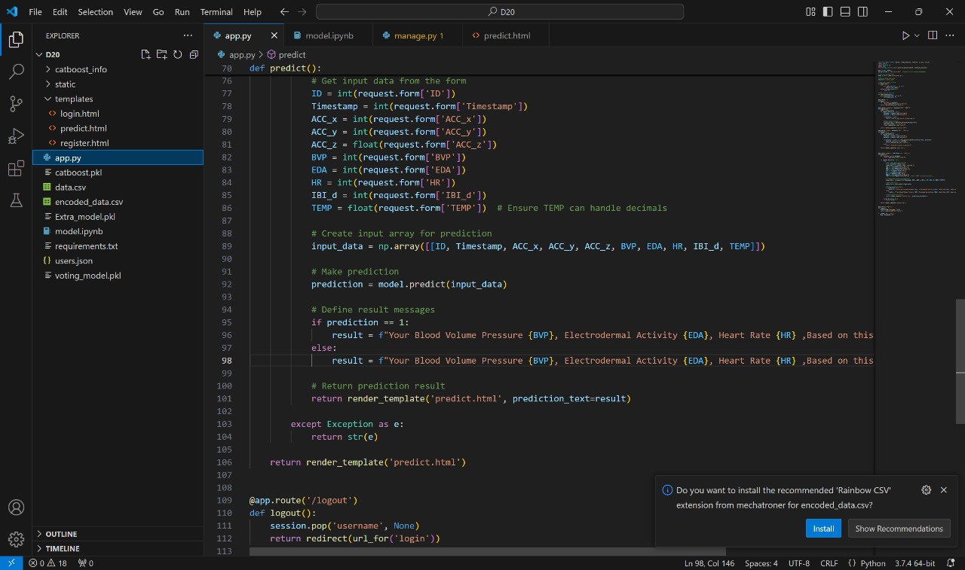

Slide 32
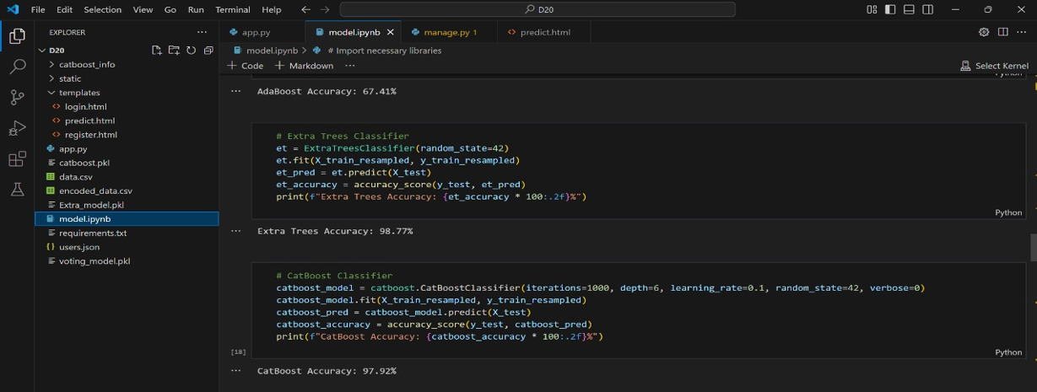
ALGORITHMS CODE

Slide 33
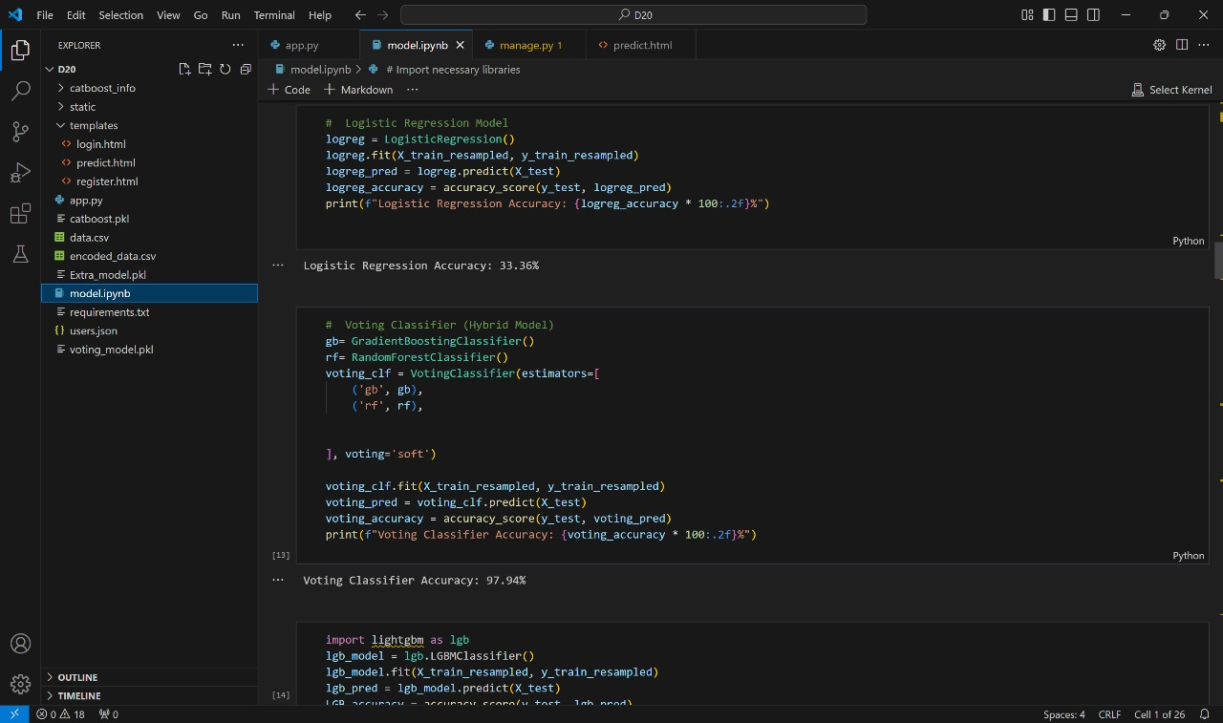

Slide 34
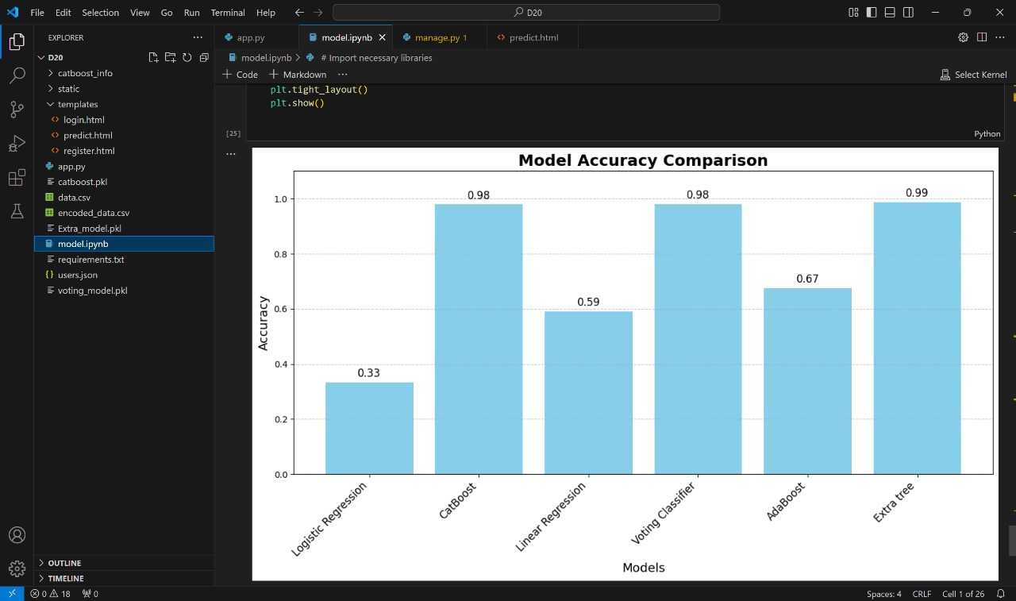
ACCURACY COMPARISION

Slide 35
SYSTEM TESTING
TYPES OF TESTING
Unit Testing
Integration Testing
Functional Testing
System Testing
White Box Testing
Black Box Testing
Acceptance Testing(User Acceptance Testing UAT)

Slide 36
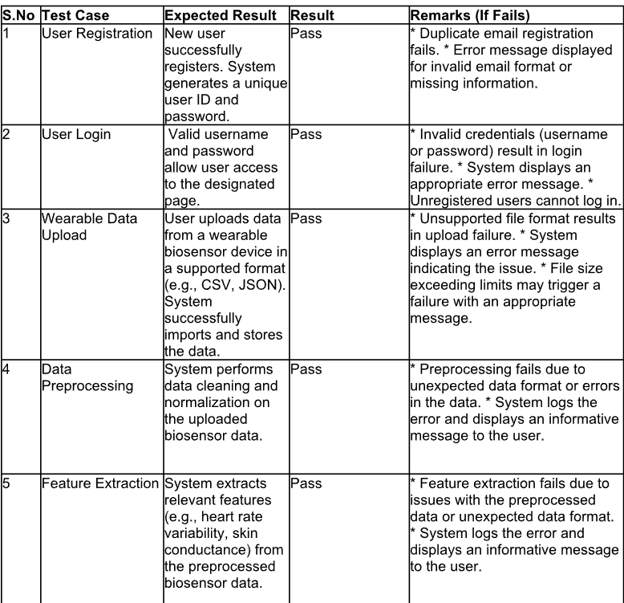
TEST CASES

Slide 37
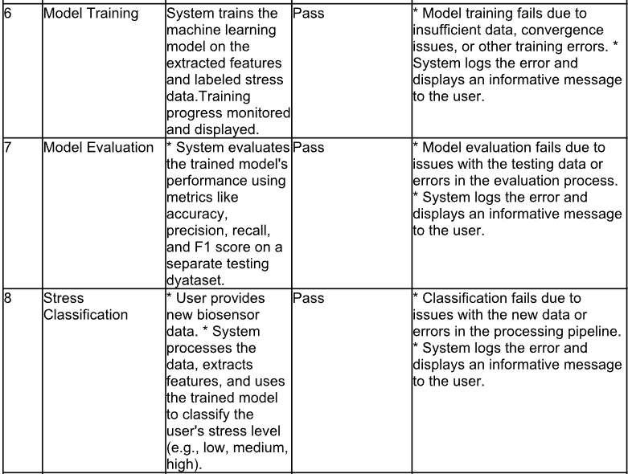

Slide 38
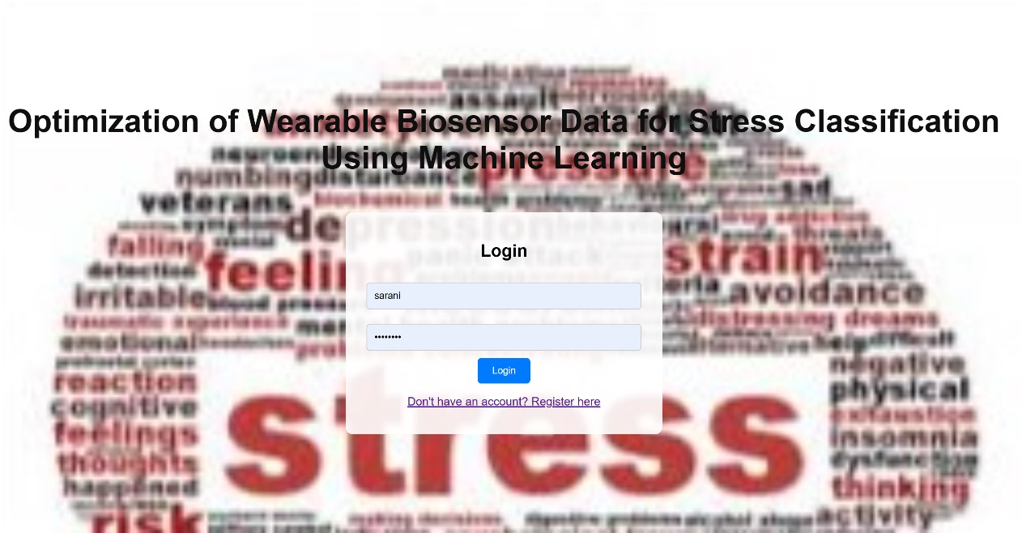
RESULTS

Slide 39
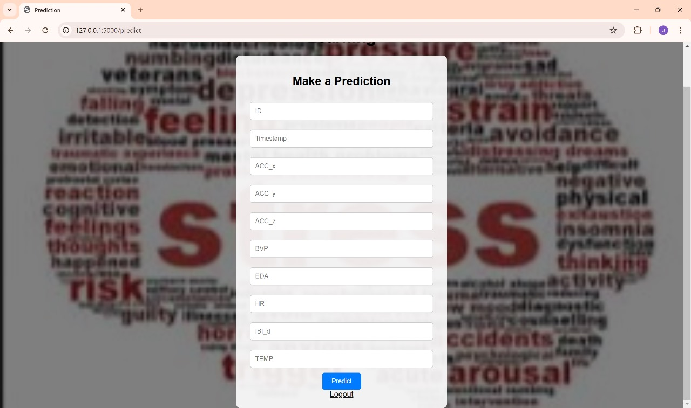
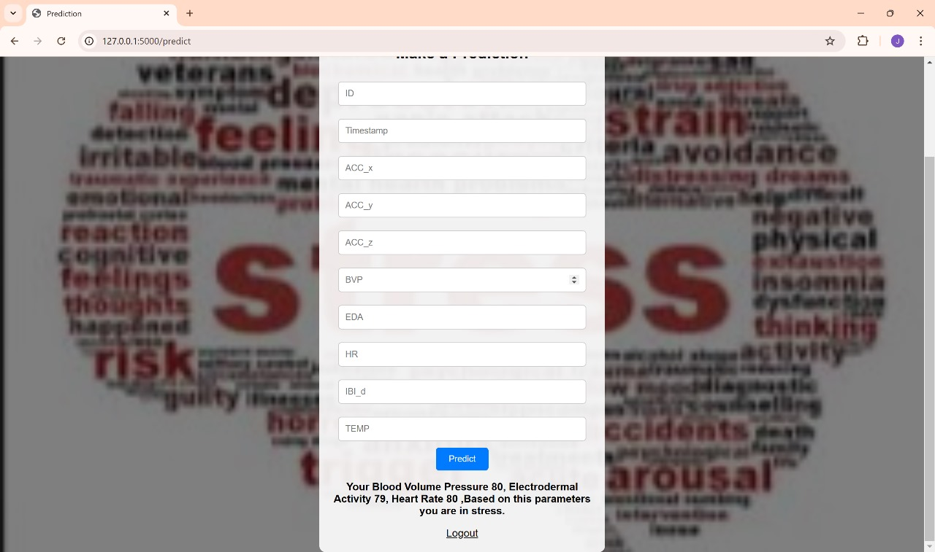

Slide 40
CONCLUSION
In conclusion, the optimization of wearable biosensor data for stress classification using machine learning and explainable AI demonstrates significant potential for enhancing stress detection and management in daily academic settings.
The integration of diverse environmental and physiological factors, advanced explainability features, and adaptability to varied conditions enables more reliable and actionable insights.
This innovative approach holds promise for supporting mental well-being, improving academic performance, and informing personalized interventions.
Future research should focus on large-scale deployments, longitudinal studies, and exploration of additional applications in education and healthcare.

Slide 41
FUTURE ENHANCEMENTS
Integration of multi-model data
Real time and personalized models
Enhanced explainability with SHAP
Robustness and noise handling
Ethical and privacy-aware solutions

Slide 42
REFERENCES
F. Fatih, Z. En-Naimani, and K. Haddouch, ‘‘Comparative Study of Bayesian Optimization Process for the Best Machine Learning Hyperpa- rameters,’’ in International Conference On Big Data and Internet of Things, pp. 239–249, Springer, 2022.
M. Benchekroun, P. E. Velmovitsky, D. Istrate, V. Zalc, P. P. Morita, and D. Lenne, ‘‘Cross dataset analysis for generalizability of HRV-based stress detection models,’’ Sensors, vol. 23, no. 4, p. 1807, 2023.
T.Androutsou,S.Angelopoulos,E.Hristoforou,G.K.Matsopoulos,and D. D. Koutsouris, ‘‘Automated Multimodal Stress Detection in Computer Office Workspace,’’ Electronics, vol. 12, no. 11, p. 2528, 2023.
S.Campanella,A.Altaleb,A.Belli,P.Pierleoni,andL.Palma,‘‘AMethod for Stress Detection Using Empatica E4 Bracelet and Machine-Learning Techniques,’’ Sensors, vol. 23, no. 7, p. 3565, 2023.

Slide 43


